Slide 1
Senate Judiciary Committee Rosters
POLS 1101 Spring 2016
Lab Three

Slide 2
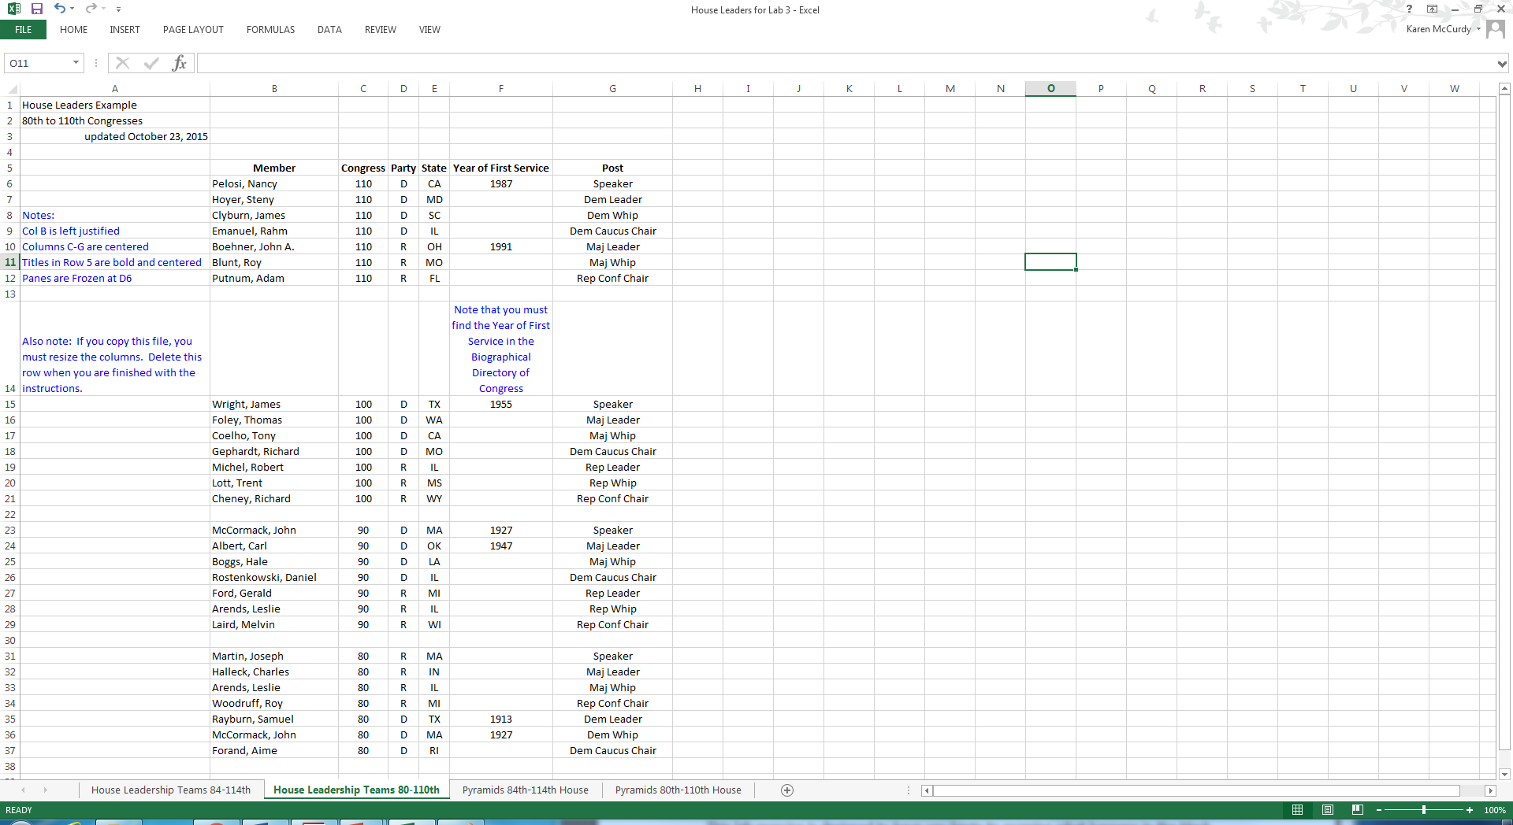
Judiciary Roster Example in Excel

Slide 3
Step One
Download the Excel Spreadsheet from Folio or Open a new file
Notice several things
1) The tabs along the bottom
Rename by double clicking inside the tab and typing
2) Sizing the column width
Double click the column title letter
3) Insert information to help you identify which files you are opening
4) Prepare to enter data by naming columns

Slide 4
Step Two
Choose your subcommittee from the six available on the Senate Judiciary Committee
1) Antitrust, Competition Policy and Consumer Rights (ACPCR);
2) Crime and Terrorism (C&T);
3) Oversight, Agency Action, Federal Rights and Federal Courts (OAAFRFC);
4) Immigration and the National Interest (INI);
5) Privacy, Technology and the Law (PTL); or
6) The Constitution.

Slide 5
The tabs can be named, just double click and type

Slide 6
The tabs can also be moved, just double click and drag

Slide 7
Adjusting Column Width
The width of columns can be adjusted by double clicking on the letter at the top of the column
You can also adjust the size by clicking and dragging the line that defines either side of the column

Slide 8
Adjust column width

Slide 9
Adjust column width

Slide 10
After adjustments are made
The file will look like the one on the next slide after you have resized and formatted your spreadsheet

Slide 11
Resized and renamed spreadsheet ready to accept data entry

Slide 12
Saving your work
Use this file naming convention
Senate Judiciary 114th
Remember to save after each step
ALERT: Do not create a new file each time you save your work

Slide 13
Ready for Data Entry on Data Sheet tab

Slide 14
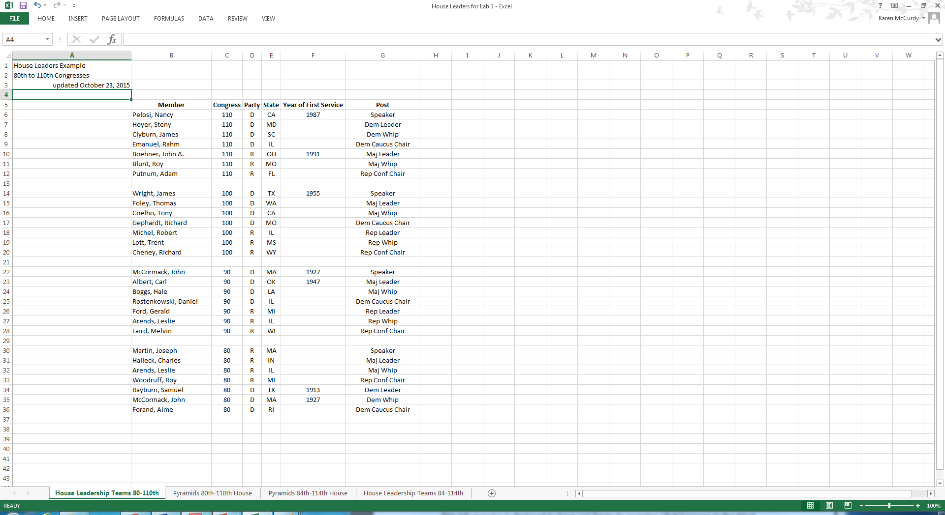
Remove Blue Notations to Turn in your Work

Slide 15
Confirm that the first two tabs are the ones you want me to grade

Slide 16
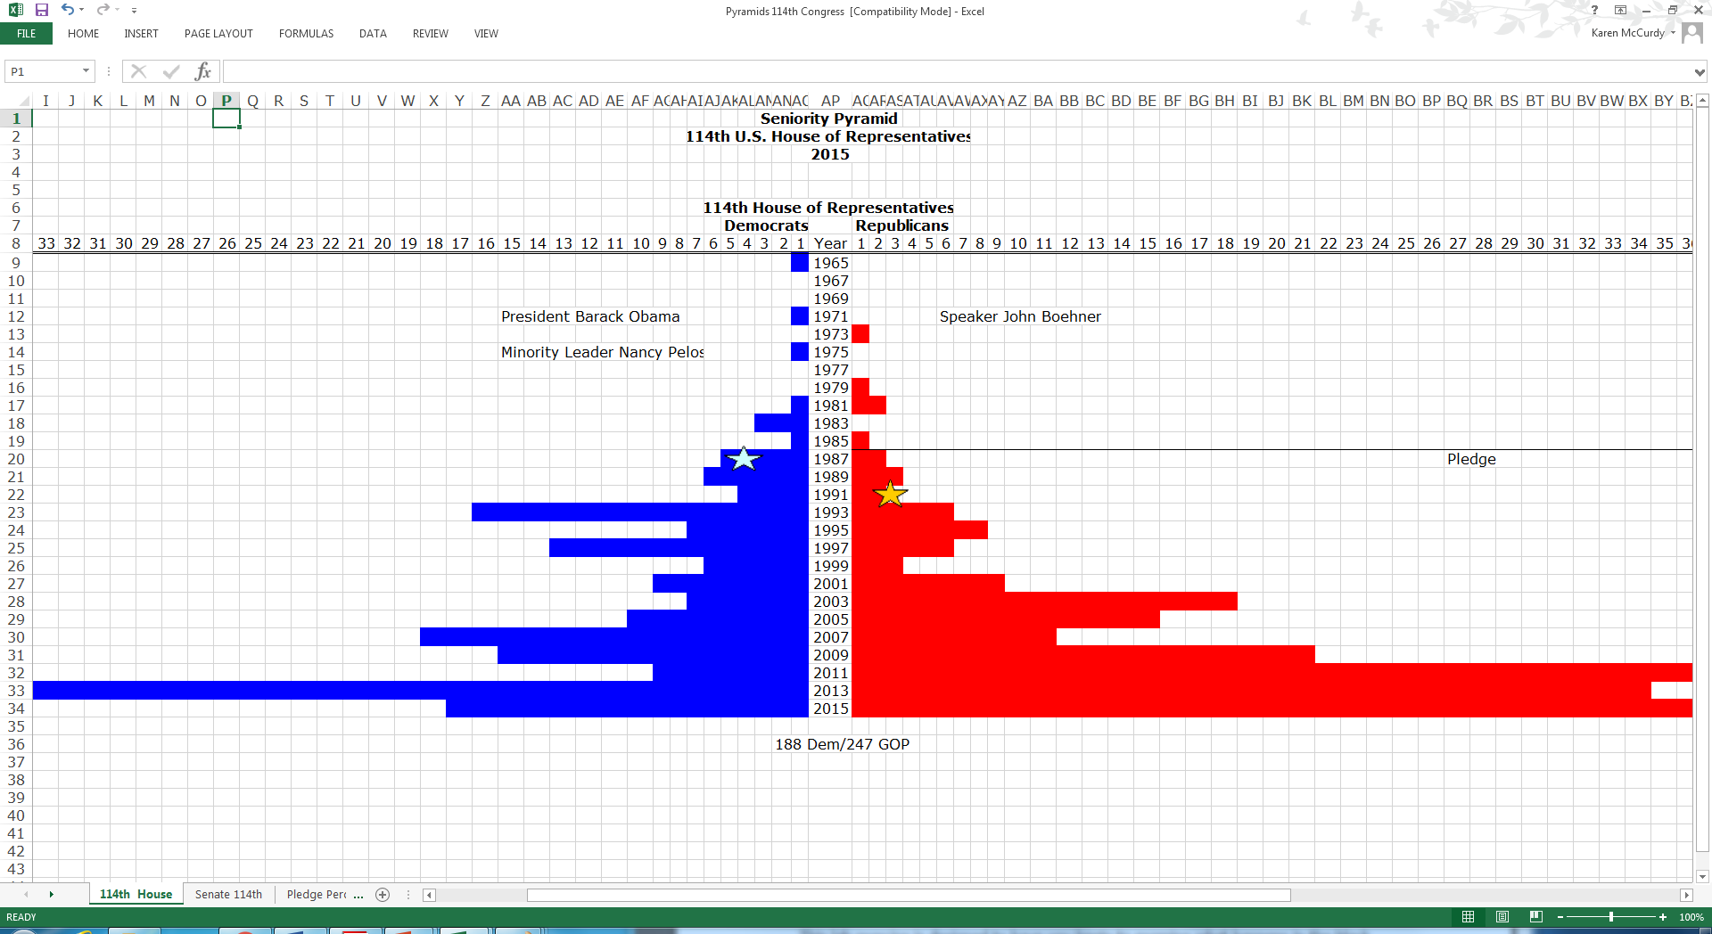
Now it is time to begin graphing your data in the Pyramids

